Slide 1

STATE OF NEVADA
DEPARTMENT OF TAXATION
CONSTRUCTION

Slide 2



CONSTRUCTION CONTRACTORS
Includes
any person who acts solely in a professional capacity to improve real property by
Adding to
Altering
Construction
Repairing
Remodeling
NAC 372.190

Slide 3


CONSTRUCTION CONTRACTORS
The following are included in this group:
Subcontractor
Interior Decorator
Specialty Contractor
NAC 372.190

Slide 4


CONSTRUCTION CONTRACTORS
The term does NOT include:
An employee
A licensed architect
A licensed professional engineer
A manufacturer of
  Modular homes
  Sectionalized housing
  Prefabricated homes
NAC 372.190(1)

Slide 5


CONSTRUCTION CONTRACTORS
Construction Contract
A construction contract for improvement to real property is a contract for
erecting
constructing
affixing a structure to real property
affixing other improvement on or to real property
remodeling
Altering
Adding or repairing an improvement to real property
NAC 372.190(2)

Slide 6


CONSTRUCTION CONTRACTORS
Construction Contract
        May be formal or informal
        Advertised contracts
        Negotiated contracts
Fixed price contracts
Cost reimbursable contracts
Lump-sum contracts
Time and material contracts
NAC 372.190(2)

Slide 7

CONSTRUCTION CONTRACTORS
Application of Tax
A construction contractor is considered a consumer of all tangible personal property purchased for use in improving real property.
A construction contractor is required to pay the tax on all material purchases that will be used in the construction job.
NAC 372.200

Slide 8



CONSTRUCTION CONTRACTORS
Government Contracts
        Tangible personal property purchased by a contractor for use in a government job is subject to the tax.
NAC 372.200(1)

Slide 9

CONSTRUCTION CONTRACTORS
Government Contracts
A contractor may not enter into a contract for a public work claiming to be a constituent part of the governmental entity which sponsors or finances the public work.
A contract for a public work may be entered into provided that the contract requires the payment of any state/local taxes that would normally be due had the contract not been with a tax-exempt entity.
(AB 332, 2015 Legislation Session, effective 7/1/2015)

Slide 10
CONSTRUCTION CONTRACTORS
Government Contracts
If the public body is going to perform the public work itself, it is not required to pay any local or state taxes for the purchase and use of construction materials or goods.
(AB 332, 2015 Legislation Session, effective 7/1/2015

Slide 11
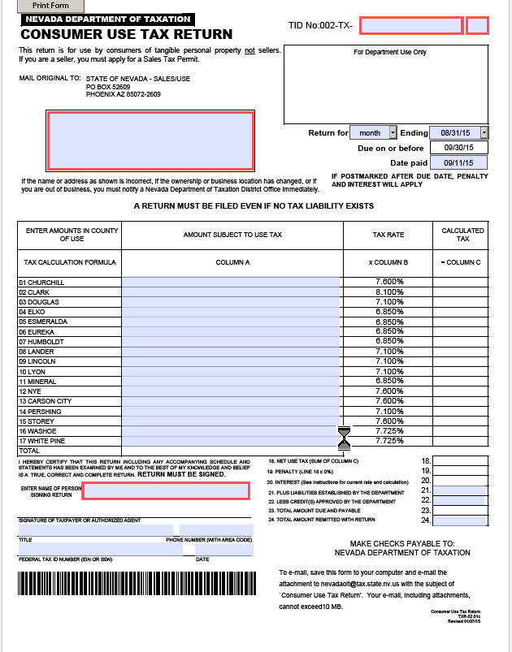
CONSTRUCTION CONTRACTORS
Consumer Use Tax Return

Slide 12
CONSTRUCTION CONTRACTORS
Change in Sales Tax Rate
Construction contractors bid future jobs which include the current sales tax rate
When the sales tax rate changes….
the construction contractor can apply for an exemption from the increased tax rate. Contractors must complete a Contract Summary Form and submit to the Department. Once approved, the contractor will be required to self-report the use tax at the former tax rate. Complete instructions and the form are available on the Department of Taxation’s website under “Common Forms”.
NRS 377B.110(6)

Slide 13
CONSTRUCTION CONTRACTORS
Resale Certificates
A construction contractor may be registered as a retailer
As a retailer, the contractor may use a resale certificate for purchases, and report the tax when the materials are used in a job or sold at retail.
A retailer construction contractor may NOT use a resale certificate for purchases of tools or supplies which are used in the trade.

Slide 14
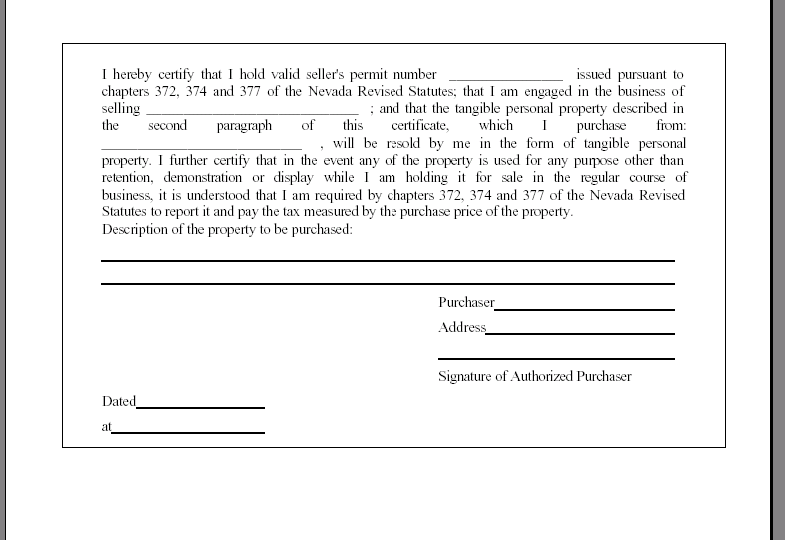
RESALE CERTIFICATE

Slide 15
CONSTRUCTION CONTRACTORS
Fabrication Labor
Fabrication labor is labor which results in the creation of tangible personal property.
Fabrication labor is taxable in a retail sale where no installation to real property is involved.
A contract for improvement to real property which includes fabrication and installation is not considered a retail transaction; the contractor is liable for tax on the materials only in such a transaction.
NAC 372.380

Slide 16
CONSTRUCTION CONTRACTORS
Purchases out of State
Materials purchased out of state and delivered to Nevada for a Nevada job are subject to Nevada tax.
Tax legitimately paid to other state is honored by Nevada; however, if the other state tax rate is lower than the Nevada rate, the difference is due to Nevada
NRS 372.185, NAC 372.055

Slide 17




RECORDS TO BE KEPT
Purchase invoices
Sales journals
General ledgers
Job files
Other records
        Must keep records for four (4) years
NRS 372.735

Slide 18

Written Response
Most tax issues can be addressed by the Department of Taxation. Please be advised that any responses to inquires made to the Department are only binding if put in writing, such as Nevada Revised Statutes, Administrative Code, Nevada Tax Notes, or in written correspondence.

Slide 19

DEPARTMENT OF TAXATION
Contact Information
Our offices are open Monday-Friday
8:00 AM – 5:00 PM
Contact our Call Center at
1-866-962-3707
Southern Nevada:
Grant Sawyer Office Building
555 E. Washington Avenue
Suite 1300
Las Vegas, NV 89101
OR
2550 Paseo Verde Parkway
Suite 180
Henderson, NV 89074
Carson City:
1550 College Parkway
Suite 115
Carson City, NV 89706-7937
Reno:
4600 Kietzke Lane
Building L, Suite 235
Reno, NV 89502

